Slide 1
BRAFAR: Bidirectional Refactoring, Alignment, Fault Localization, and Repair for Programming Assignments
Thi Van Anh Dau

Slide 2
Limitation of previous works
CLARA and SARFGEN
fail to provide feedback with unique control-flow structures
Refactory
randomly applies refactoring and mutation operations to correct buggy programs
low success rate, complicate the original repair task
generate repairs for each basic block
produce unnecessary repairs

Slide 3
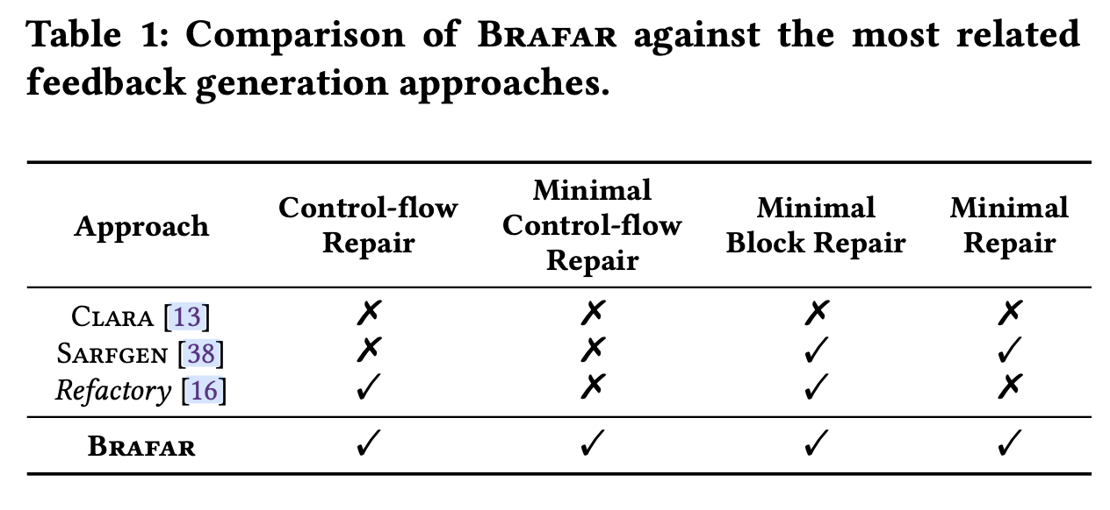
Limitation of previous works

Slide 4
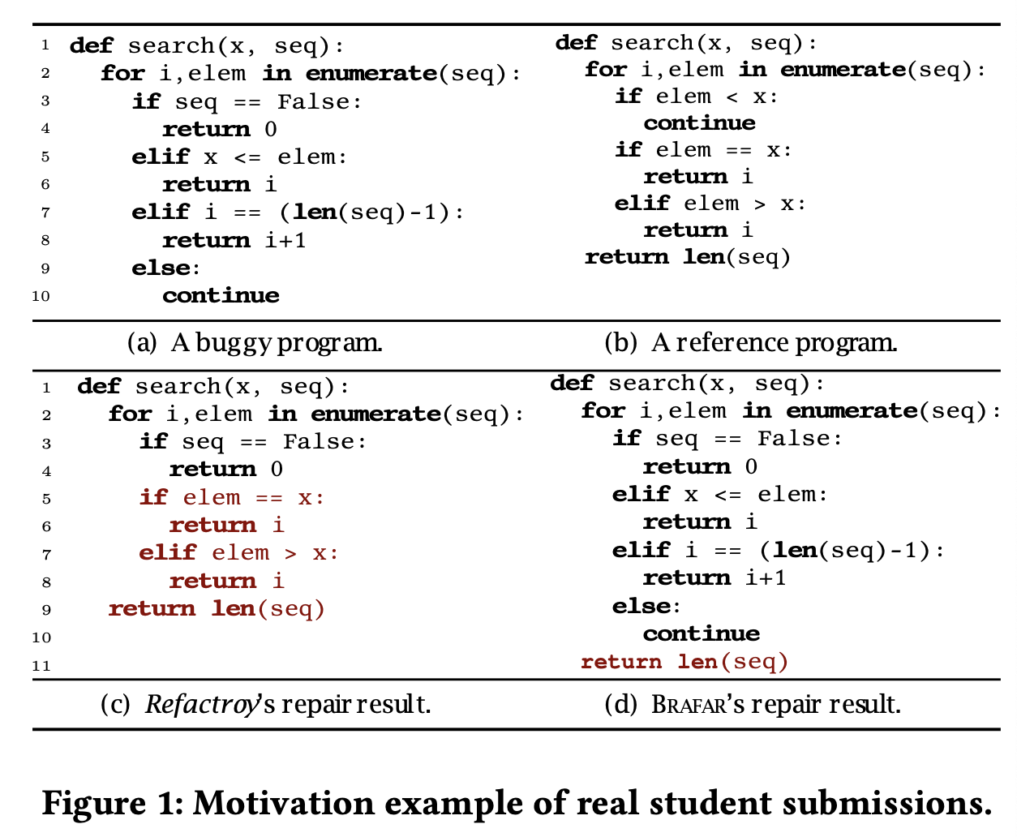
Motivation Examples

Slide 5
Introduction to BRAFAR
Fully automated program repair tool
Bidirectional refactoring algorithm: align two different control-flow structures with small modifications
Coarse-to-fine fault localization: reduce unnecessary repairs

Slide 6
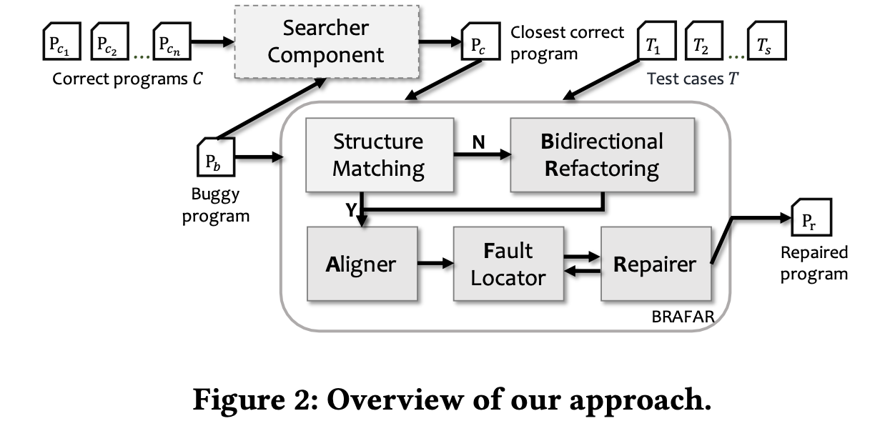
An overview of BRAFAR

Slide 7
An overview of BRAFAR
Input: Correct program, Buggy program, Testcase.
Step 1: Search the closet correct program
Step 2: Bidirectional refactoring
align their control-flow structures.
Step 3: Program repair
Aligner: aligns the basic blocks and variables
Fault Locator: locates the suspicious basic block
Repairer: repair until the generated program passes all testcases

Slide 8
Tool Demonstration

Slide 9
Thanks for listening

